Slide 1
DATE
Ovcharuk Darya
20/03/2024
BANK SYSTEM
England vs PMR

Slide 2
PLAN:
Banking System of PMR
Main specs and system structure
Role of banking system
System efficiency and stability
01
General overview of bank system
Definition of the banking system
Role bank system in global economics
02
Banking System of England
Structure and organizations of banking system
Role of banking system
Regulation and supervision
03
04
Comparasion of systems&results

Slide 3

The banking system is a network of financial institutions that collect savings and provide loans, stimulating economic growth. It ensures liquidity, manages risks, and facilitates international transactions, playing a key role in the global economy and monetary policy.
The banking system mobilizes savings, risk management and global scaling and prospertity
BANKs System

Slide 4

BANKING SYSTEM of PMR
Banking system of Transnistria. It consists of two levels: the Transnistrian Republican Bank and commercial banks. The Republican Bank regulates capital and risk adequacy and sets minimum capital requirements for all commercial banks registered in the country.
Main goals of the central bank:
* Ensuring the implementation of key directions of unified state monetary policy.
* Maintaining stability and development of the banking system.
* Establishing and maintaining conditions for the country's consistent and sustainable economic development.
* Ensuring the stability of the national currency.
Profit-making is not the primary goal of the central bank's activities.

Slide 5


ROLE
STABILITY
The banking system plays a pivotal role in the economy by mobilizing savings and directing them towards productive purposes through loans and investments. It ensures financial stability by providing liquidity and managing risks, while also influencing international trade and monetary policy, laying the foundation for growth and prosperity on a global scale.
Ensuring financial stability through effective registration of foreign investments and participation in deposit insurance. Effective regulation and supervision of insurance activities to protect the interests of policyholders and ensure the sustainability of the sector. Enhancing transparency and reliability of financial reporting of insurance organizations by adopting accounting standards. Maintaining financial stability by ensuring exchange rate stability and effective regulation of foreign exchange operations.

Slide 6
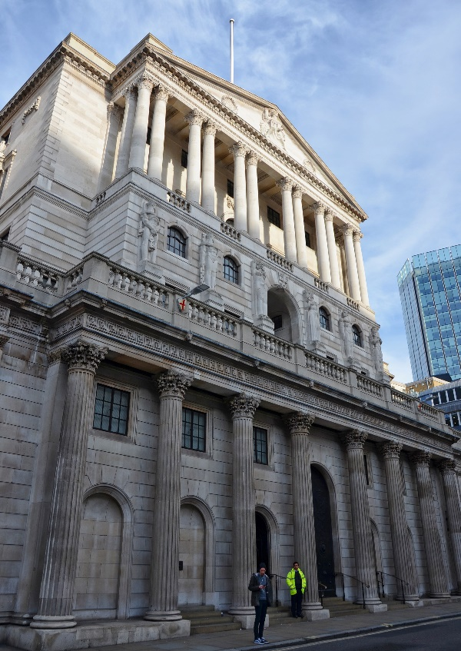
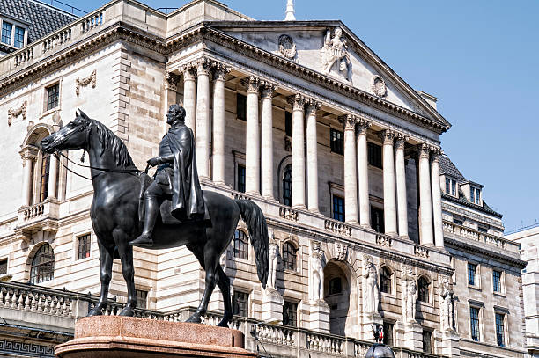
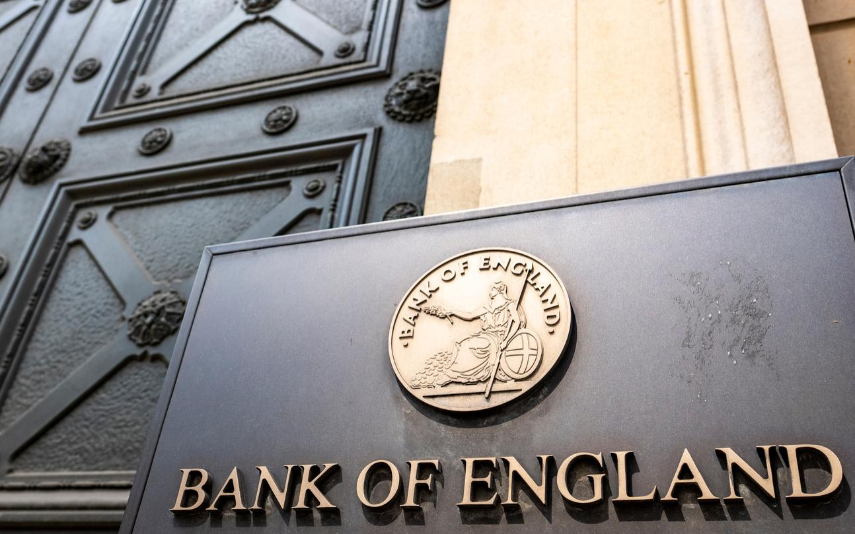
BANKING SYSTEM of ENGLAND
Has 3 structures.
1 st is occupied by the Bank of England, whose main objectives include supporting the exchange rate of the national currency and ensuring the stability and competitiveness of the financial system
2nd is occupied by specialized commercial banks, controlled by both residents and non-residents, and securities companies. 3rd is represented by building societies and credit unions. All commercial banks of Great Britain are divided into three types depending on their specialization: clearing, trading and savings banks.

Slide 7
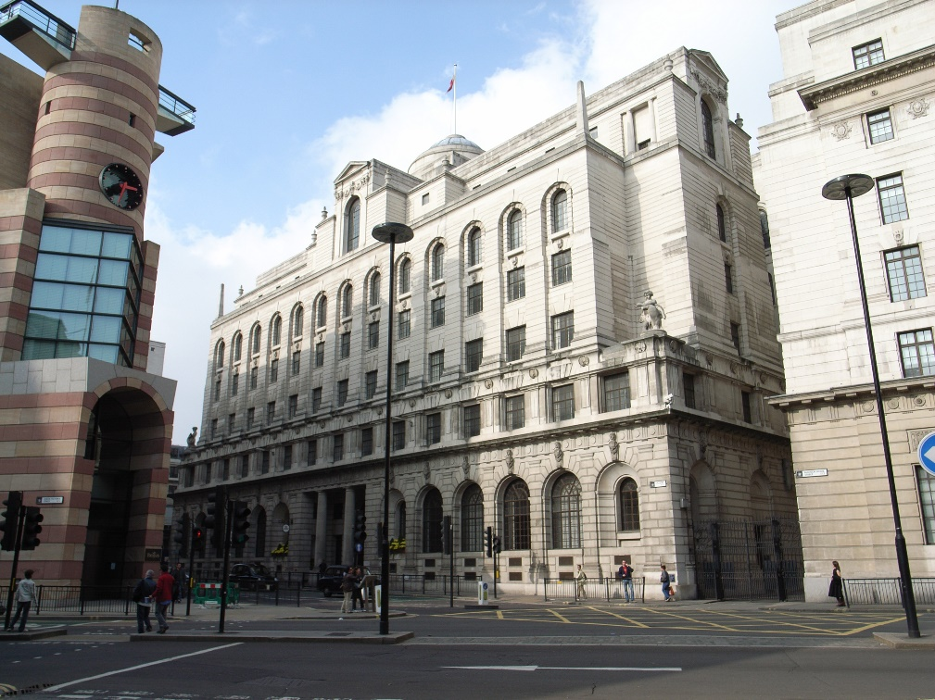
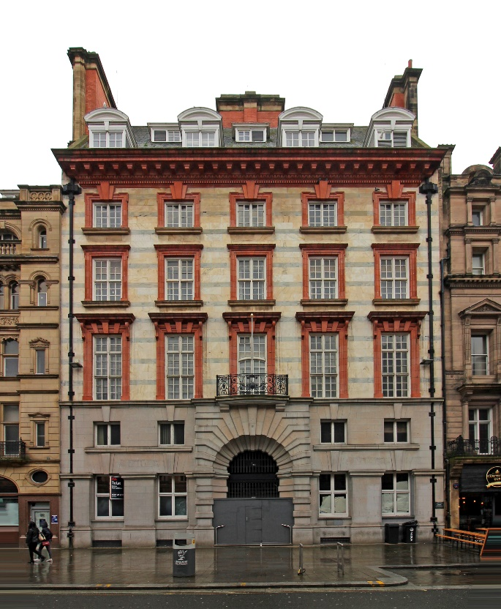
Role
The main roles of the banking system in England include:
Financing the economy.
Managing money and payments.
Maintaining financial stability.
Functions of the central bank.
Government financing.
International role.
The four largest banks in the UK belong to the clearing bank: National Westminster Bank, Lloyd's Bank, Midland Bank, Barclay's Bank. Merchant banks are involved in foreign trade and international financial and credit operations and do not accept deposits.

Slide 8

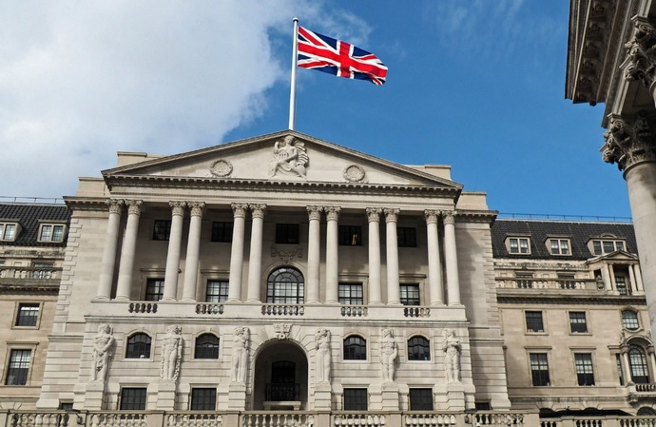

BANKS of England
Savings banks
Merchant banks
Clearing banks
01
02
03
Play a central role in a nation's banking industry, facilitating deposits, loans, and serving as its foundation. They manage interbank transactions in line with local regulations, providing diverse services tailored to specific territories or sectors.
To serve the agencies that established them and, in fact, they are banks with state capital. The best known of these are the National Savings Bank (a division of the Ministry of National Savings), the Trust Savings Bank and the National Fat Bank, which is used only by the public authorities for payments to the public.
Operate in the field of foreign trade and international financial and credit operations and do not accept deposits.

Slide 9
Match English and Russian equivalents.
A stock market
Фондовый
рынок
A default
Ипотечное кредитование
Forgery
Процентная ставка
Interest rate
Процентная ставка(кап. д.)
A credit rating
Подделка
(купюр)
An encashment
Кредито- способность
Creditworthiness
Дефолт
A payment guarantor
Ставка
рефинанс-ия
Capitalization
Процент
Capitalization rate
Рейтинг кредитования
The Int. Monetary Fund
Инкассация
Refinancing rate
Капитализация
Credit history
Международный валютный фонд
A mortgage loan
Поручитель по платежам
An interest
A fine
История кредитования
Штраф
General Lien
Паво на арест(имущ.)

